Slide 1
RUNGTA COLLEGE OF DENTAL SCIENCES & RESEARCH
INTRODUCTION SCOPE OF DENTAL PUBLIC HEALTH
DEPARTMENT OF PUBLIC HEALTH DENTISTRY

Slide 2
Specific learning Objectives
At the end of this presentation the learner is expected to know ;
Sr. No. | Learning Objectives | Domain | Level | Criteria | condition
1. | Know history of dentistry | Cognitive | Must know | 02
2. | Discuss development of Community dentistry | Cognitive | Must know | All
3. | Enlist aims, objectives & scope of community dentistry | Cognitive | Nice to know | All
4. | Define of Preventive dentistry | Cognitive | Must know | All
5. | Define of Community dentistry | Cognitive | Must know | All

Slide 3
Table of Content
History of dentistry
Development of Community dentistry
Aims of community dentistry
Objectives of community dentistry
Scope of community dentistry
Definition of Preventive dentistry
Definition of Community dentistry

Slide 4
History of Dentistry
Ancient era dental diseases-used as themes.
Advice from priests for all their problems.
Royal physicians and Barbers
They used to do all types of treatment.

Slide 5
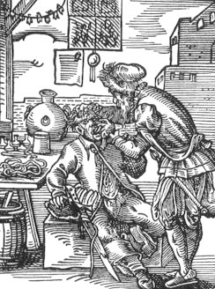

Slide 6
Monks & Priests were required to be shaven.
They used to do all treatment.
Barbers were appointed for this purpose.
Priests not allowed to do blood operations.

Slide 7
Experienced barber surgeons train fresher.
Teaching institutions started.
By giving university degrees.

Slide 8
History of Dentistry in India.
In 600 BC, Shushruta extracted teeth.
All these taught in Gurukula.
Gradually dental teaching institutions started.
In 1920 , Dr. Rafiuddin Ahmed.

Slide 9
Later, Dental institutions started
1948, Dentist act was passed & regulated
Bhore Committee - new dental colleges

Slide 10
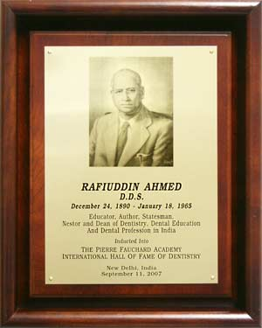

Slide 11
Development of Community Dentistry
Evident in Egyptian mummies (1500 Yrs ago).
Hippocrates advocated to prevent diseases.
19th Century, prevention,oral diseases started.
20th Century, more specific steps taken.

Slide 12
In 19th Century;
Restorative procedure became prominent
It started with private practice.
Gold & Silver restorations -made by dentist.
In 1884, Rein coined the term “Oral Hygiene”

Slide 13
In 1st two decades of 20th Century
Awareness created about oral hygiene.
1908, GV Black, discussed brown stain on teeth
Dr. Fredrick McKay of Colorado
Colorado stain (Mottled enamel) discussed

Slide 14
From 1920 to 1950
Scientific basis, preventive dentistry established
Predisposing factors in dental caries found.
Vitamins and nutritional factors explained.

Slide 15
Regular dental colleges were started.
Dentist & dental auxiliaries came into existence.
Role of fluorides in preventing dental caries.

Slide 16
After 1950;
Modern era in Community Dentistry started.
Most of the dental disease can be prevented.
Expansion in dental services.

Slide 17
Planned fluoridation of water supply.
Use of fluoride tooth paste became popular.
Scope of community dentistry has started.
It is included in BDS curriculum.
Started with MDS degree courses too.

Slide 18
Aims of Community Dentistry:
To prevent & Control oral diseases.
To promote oral health.
Organized community efforts.

Slide 19
Objectives of Community Dentistry:
To get knowledge about preventive dentistry.
Public health problems in India.
Nutrition, environment & their role in health.
Conducting health survey, health education

Slide 20
Scope of Community Dentistry
To do survey -prevalence of dental diseases
Helping Government in planning and preventive programs.
In coordinating the dental camps.
In Community trials, clinical trials,

Slide 21
Health services (WHO, UNICEF)
In army (AFMC-Pune)
In all health sector (Administrative job)
In Ministry of Health (State/Central)

Slide 22
Preventive Dentistry
It is defined as;
“specialized branch of dentistry which deals with prevention and interception of the progress of all dental & oral diseases, prevention & limitation of disabilities & provides rehabilitation”

Slide 23
Community Dentistry
It is defined as;
“specialized branch of dentistry which deal with delivery of comprehensive dental & oral health care to the masses so as to improve the total dental & oral health of the community as a whole”

Slide 24
SUMMARY
Dental public health has emerged effectively;
In the prevention of oral diseases,
screening for an early diagnosis
and prompt treatment
palliative care for those in the terminal stage.

Slide 25
Expected Question
Aims and Objectives of Community Dentistry (SAQ)
Scope of Community Dentistry (SAQ)
Define preventive dentistry(SAQ)
Define community dentistry (SAQ)

Slide 26
Bibliography
Community Dentistry, by Vimal Sikri,Poonam Sikri, 1st Edition,CBS Publishers, Chpt.1 ,pg no.1-18
Textbook of Essentials of Preventive & Community Dentistry, by Soben Peter, 3rd Edition. Arya Publishers, Chpt. 1,pg no.1-20
Textbook of Preventive and Community Dentistry,1st Edition, by S.S. Hiremath,Elsevier Publications, , Chpt.1 ,pg no.3-18

Slide 27
THANK YOU

